Slide 1
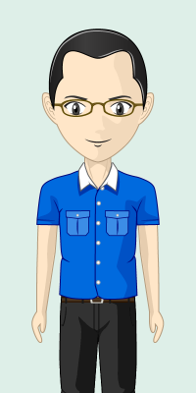
Works in an office.
Does most of his work on his laptop which he brings home everyday.
Describes himself as a “keyboarder”.
John

Slide 2

John’s First Day at Work…

Slide 3
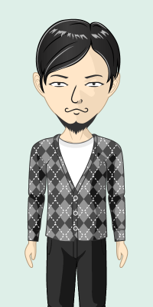
Boss: Can you go through these documents and give me a report by evening?
John: Yes boss!
John
Boss

Slide 4
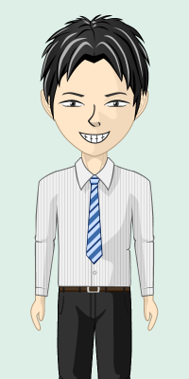
Manager: Bring 20 cups of coffee to the meeting later!
John: Yes, will do!
John
Manager

Slide 5
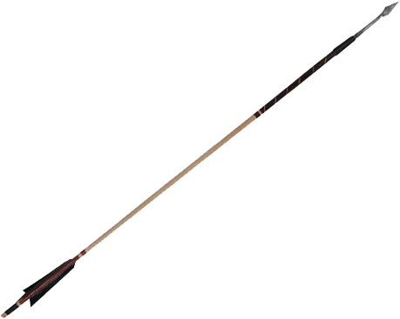


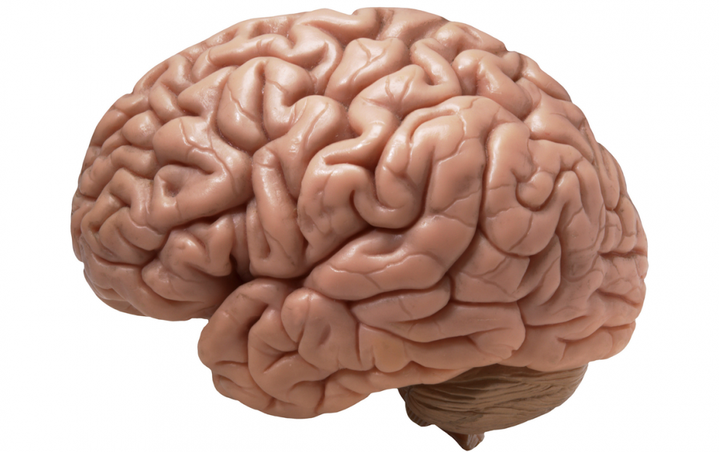




John’s Brain

Slide 6
Later in the evening…

Slide 7




John’s Brain

Slide 8
The following day…

Slide 9


John

Slide 10
Boss: You did a great job! Someone like you should do 5 reports per day!
John: Yes boss!
John
Boss

Slide 11

5 Reports Today
For boss
New Buddy’s
Report
30 Cups of Coffee
for meeting later
Buy more coffee
powder

Slide 12
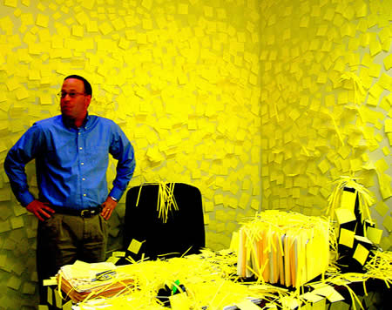
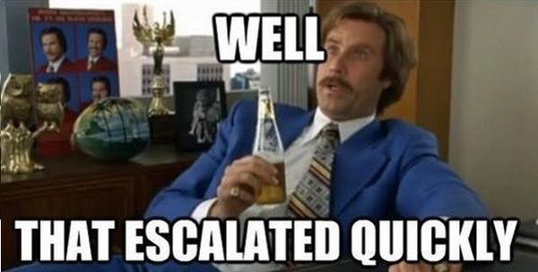

Slide 13
Yet another day later…

Slide 14
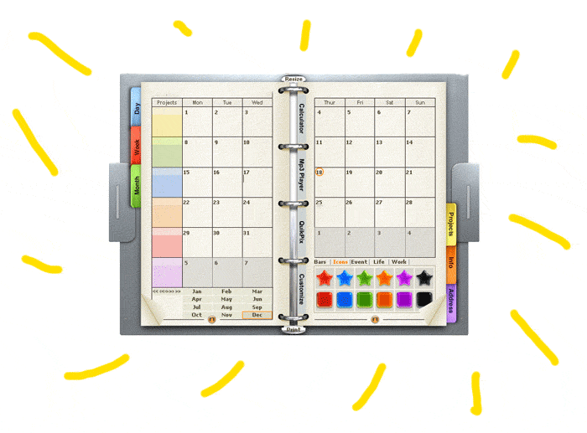
John

Slide 15
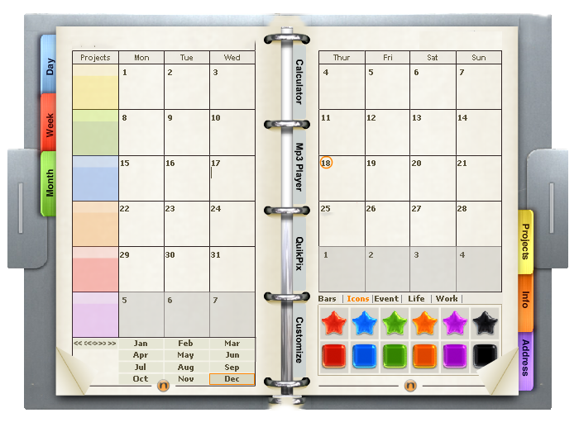
Borrow
borrow
10 reports today
Walk boss’s cat
Friend’s report
50 cups of coffee
some tiny task that I can’t read
Borrow some space here

Slide 16


Borrow
borrow
10 reports today
Walk boss’s cat
Friend’s report
50 cups of coffee
some tiny taskthat I can’t read
Borrow some space here

Slide 17
…

Slide 18

John

Slide 19
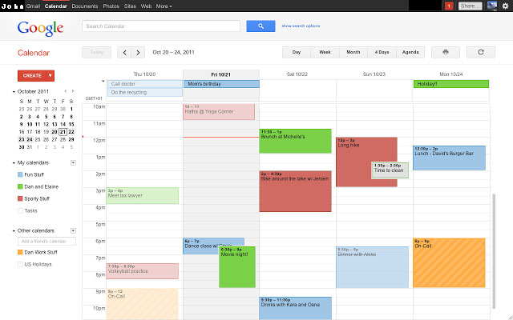
Everything’s going so smoothly today!

Slide 20
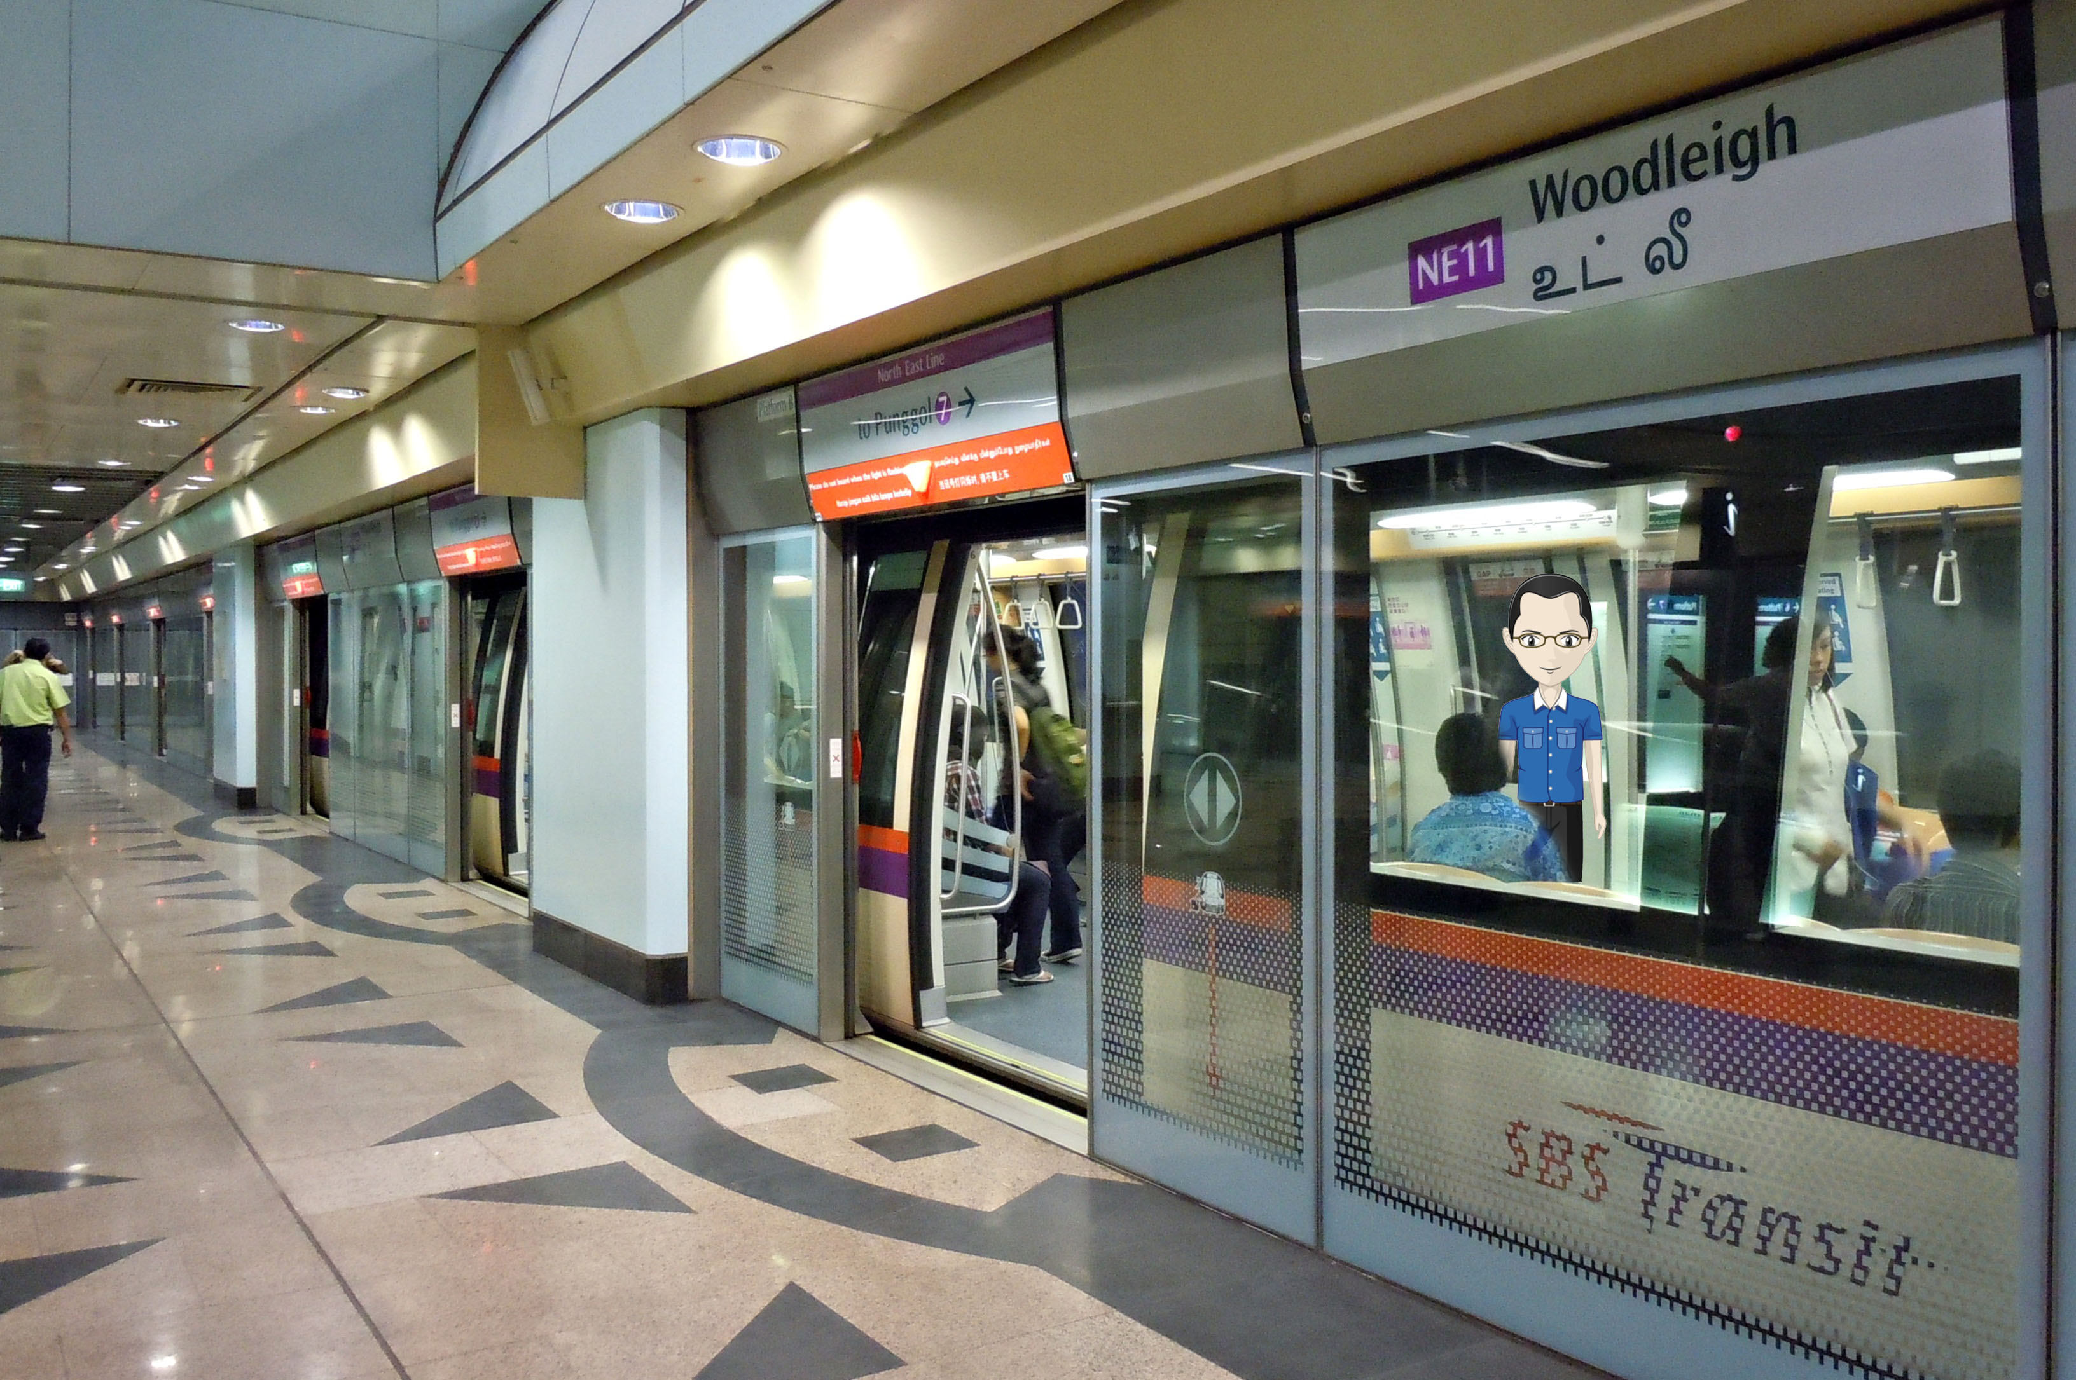

Slide 21
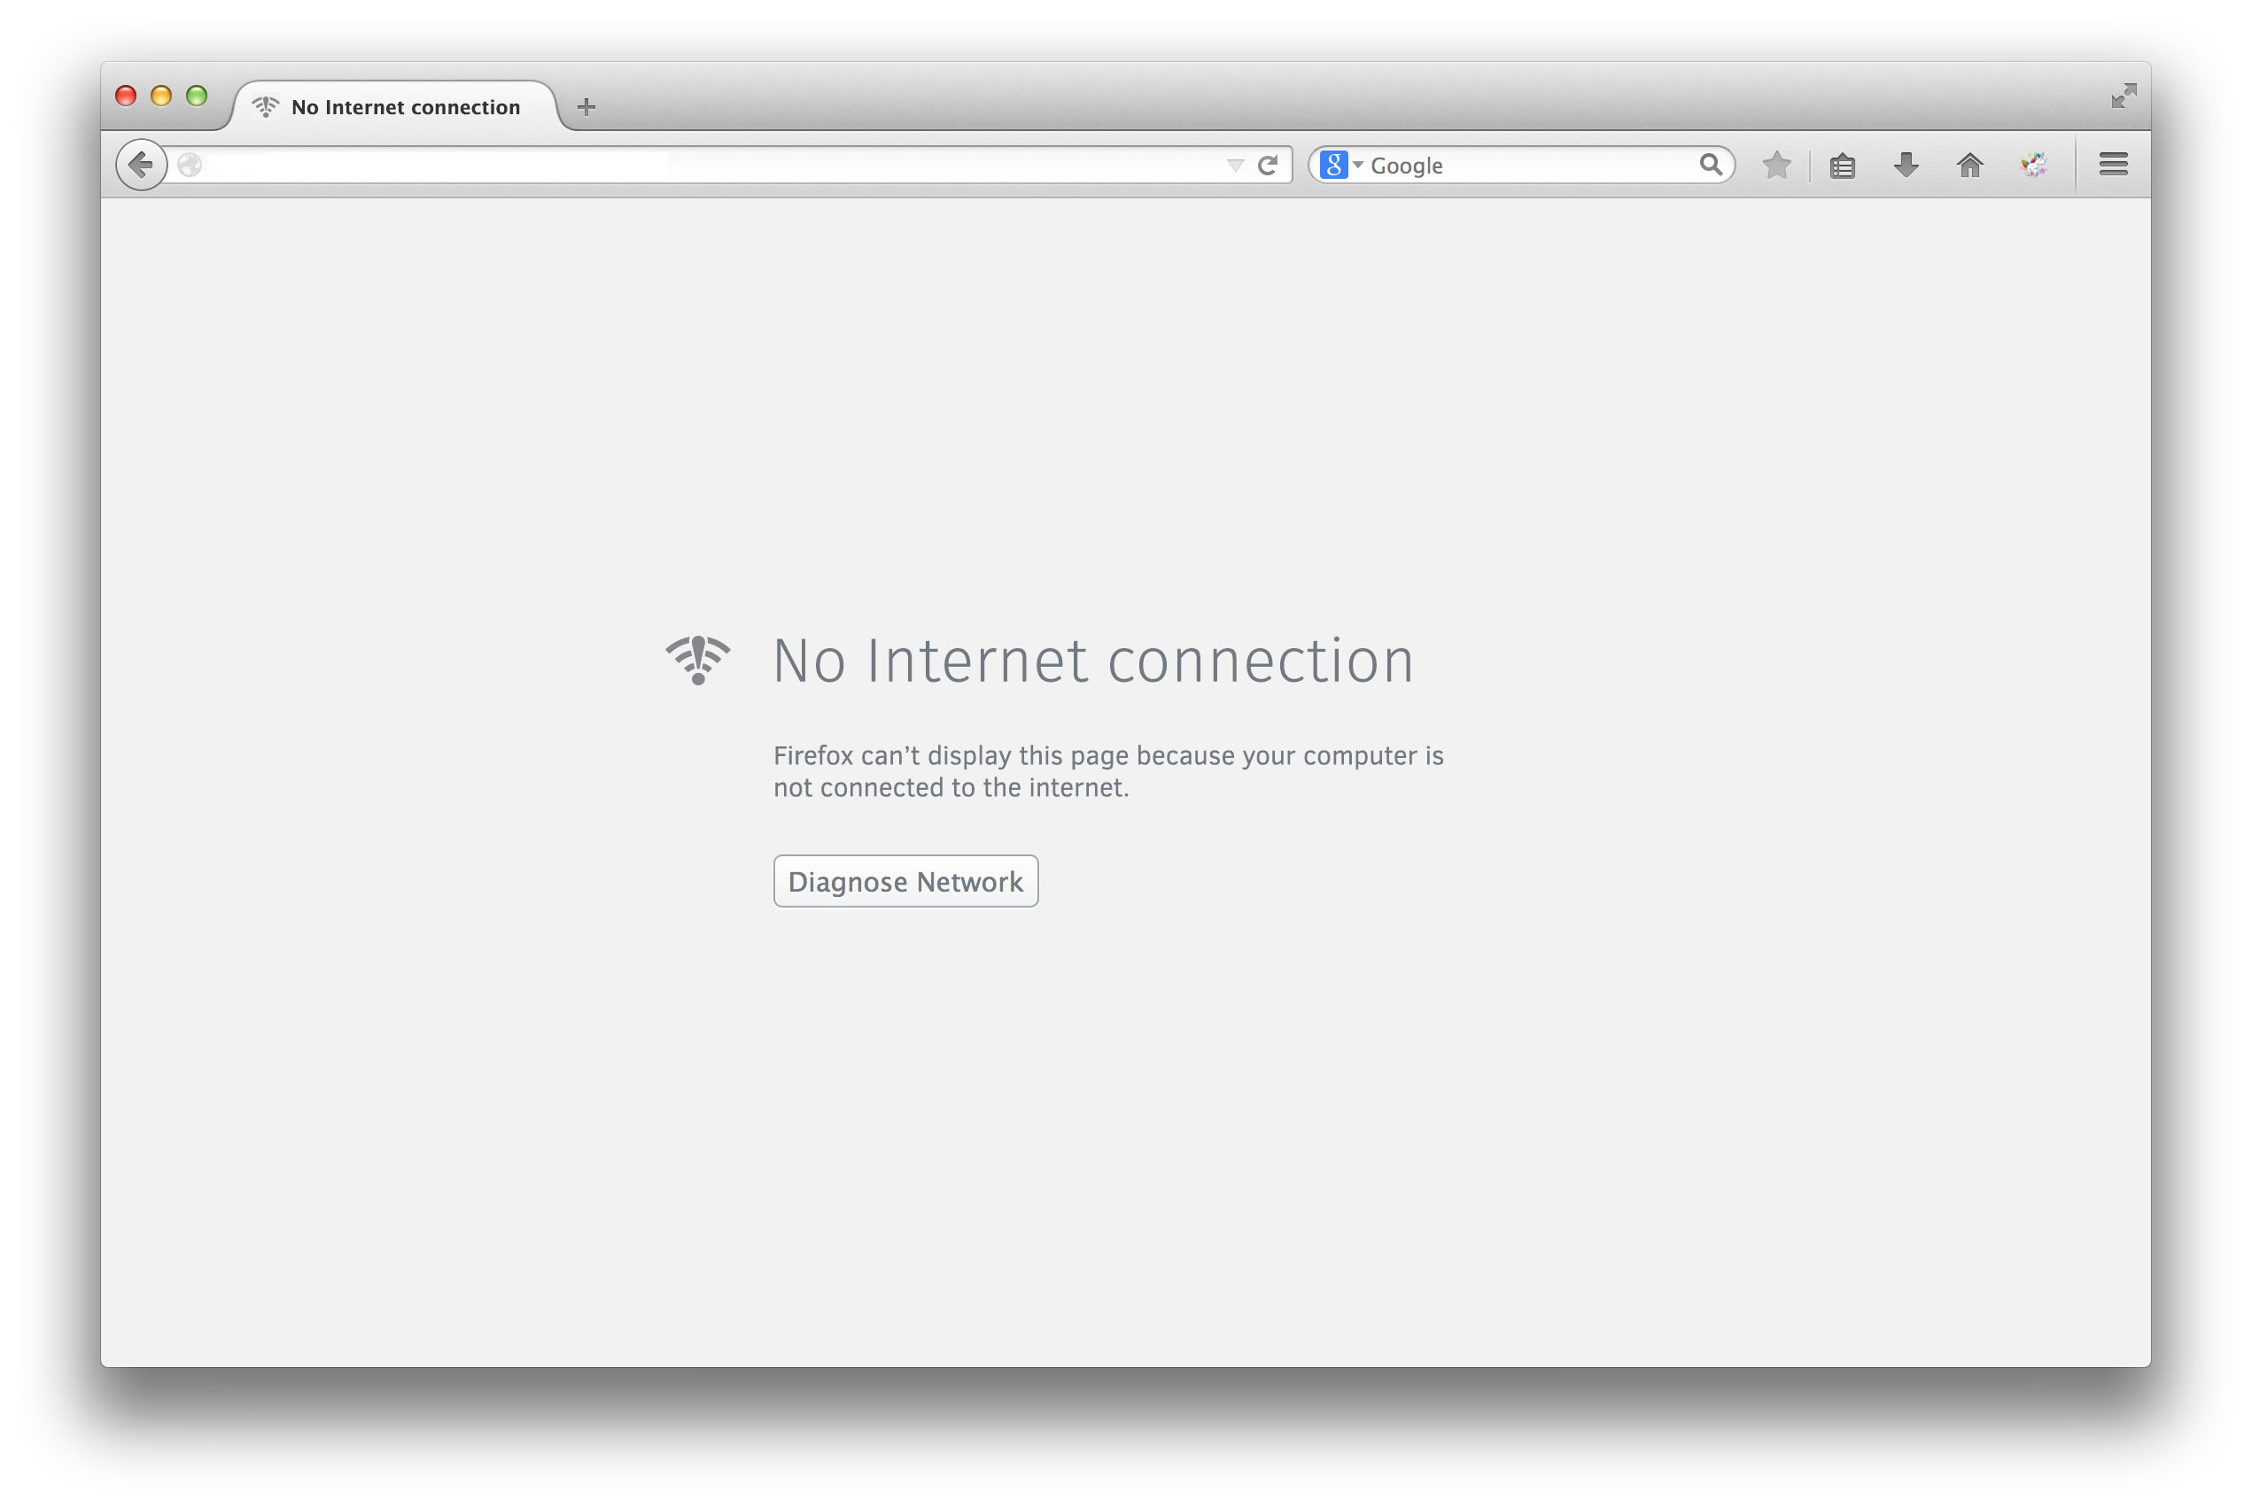

Slide 22
Have a busy schedule?
Type faster than you can write?
Need to manage your tasks centrally?
Don’t want to use the mouse so much?
Want to manage your schedule without an Internet connection?
YES!

Slide 23
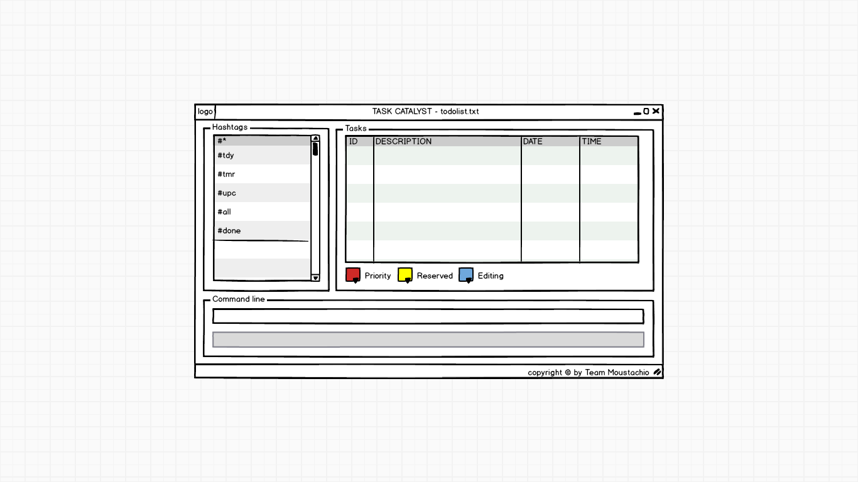
Task Catalyst

Slide 24


Task Catalyst

Slide 25


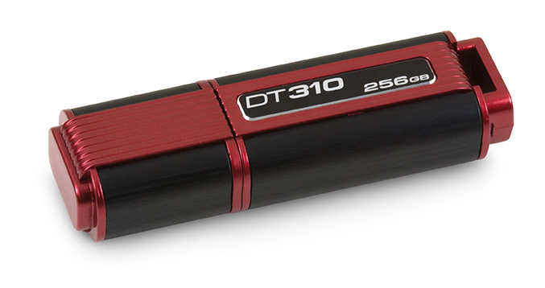
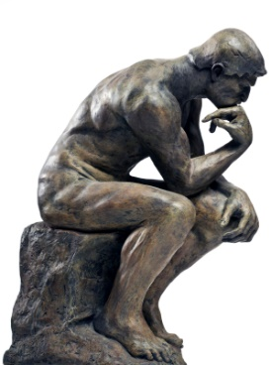
Vision
What am I doing next??

Slide 26
What Task Catalyst Can Do
C
R
U
D
reate
ead
pdate
elete

Slide 27

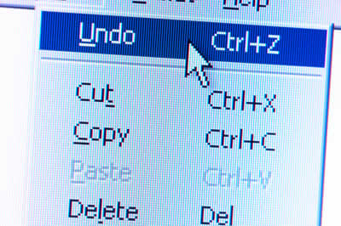

What Task Catalyst Can Do

Slide 28
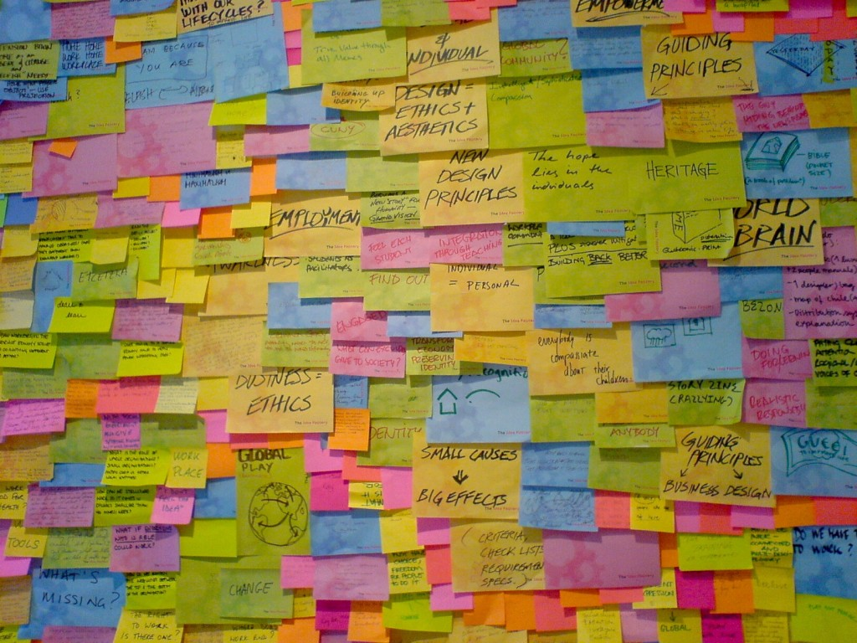


What Task Catalyst Can Do
One Hour Later…

Slide 29

What Task Catalyst Can Do
Physics Online Assignment 1
CS2101 Reflection

Slide 30






Default tags
USER INTERFACE
All task
User tags
Colour legends
Command bar
Help bar

Slide 31

Creating task is as easy as

Slide 32

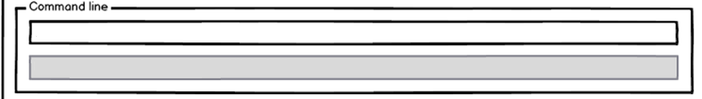
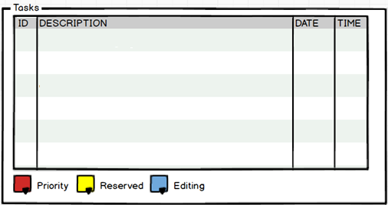

Directors meeting
on 30/8/14 at 12, #* #meeting
Directors meeting on [DD/MM/YY] at [HH:MM], #* #work #meeting
1 Directors meeting 30/8/14 12:00
#meeting

Slide 33
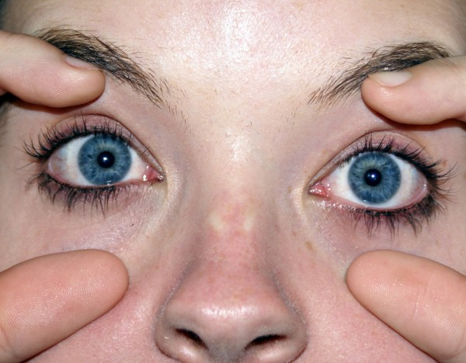
Read task is as simple as
OPENING OUR EYES

Slide 34
#tdy
1 Directors meeting 30/8/14 12:00
2 Check email 30/8/14 12:30
3 Buy lunch for colleagues 30/8/14 12:40

Slide 35

What about
editing task?

Slide 36
edit 2 on 31/8/14
edit [ID] [Description] on [date] at [time]
1 Directors meeting 30/8/14 12:00
1 Directors meeting 30/8/14 12:00
2 Check email 31/8/14 12:30
OBSERVE
3 Buy lunch for colleagues 30/8/14 12:40
3 Buy lunch for colleagues 30/8/14 12:40
2 Check email 31/8/14 12:30

Slide 37


And lastly,
deleting task
& completing
task

Slide 38
delete 2
delete [ID]
1 Directors meeting 30/8/14 12:00
1 Directors meeting 30/8/14 12:00
3 Buy lunch for colleagues 30/8/14 12:40
2 Check email 31/8/14 12:30
3 Buy lunch for colleagues 30/8/14 12:40

Slide 39
Schedule – 9 weeks
Do
Check
Release
Plan

Slide 40
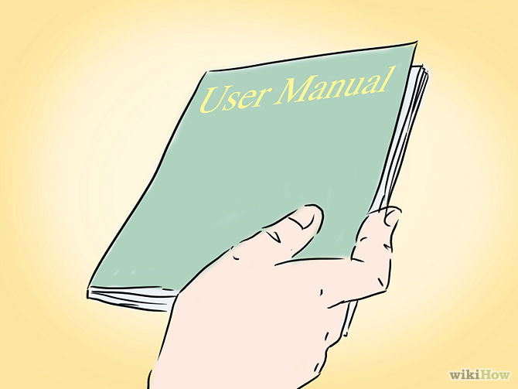
Week 5
Project manual

Slide 41
Week 6
Week 7
Code skeleton, GUI
Welcome to Task Catalyst
Buy coffee for meeting
Create
Write Reports
Remove
Meeting at 9am
Read
Help colleague’s work
Update
Printing reports
Text Here|

Slide 42

Week 8
Major improvement for the product
Add some more new features
Notes:
.

Slide 43


Week 9
Update project manual
Improve code stability
Notes:
On week 9, we shall make some necessary updates on the project manual and that’ll be our final project manual. Here, we shall also add more security to our codes.

Slide 44

Week 10
Week 11
Do systematic Testing

Slide 45

Week 12
Beta version of the product

Slide 46

Week 13
Release final product

Slide 47

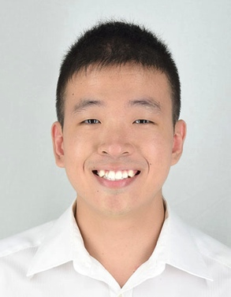
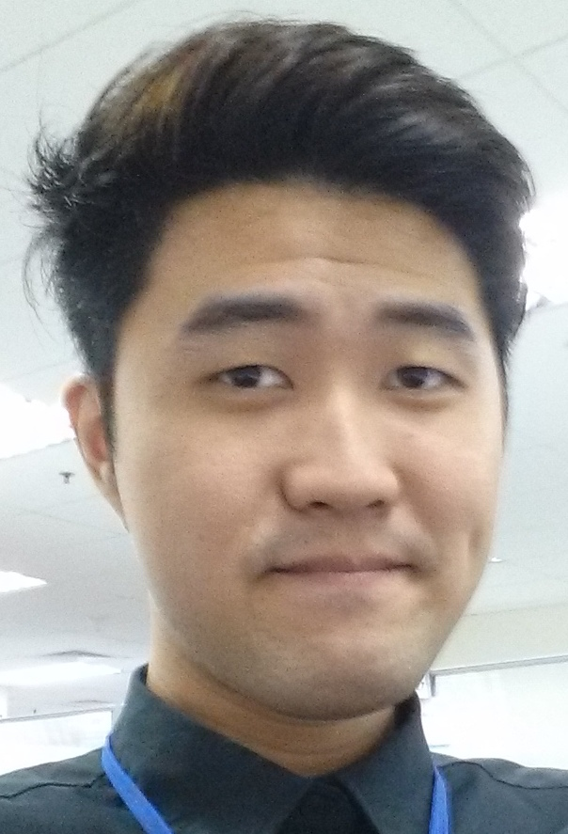
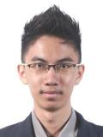

Team Members
Kelvin
Zhen Yu
Wei Jie
Thida
Proficient in java programming languages
Proficient in C# language, code quality
Proficient in testing, debugging
Proficient in finding resources and testing program

Slide 48
Thank You

